Slide 1
Learn OpenGL

Slide 2
目录
CONTENTS
1
阴影映射
2
点光源阴影

Slide 3
1
阴影映射

Slide 4
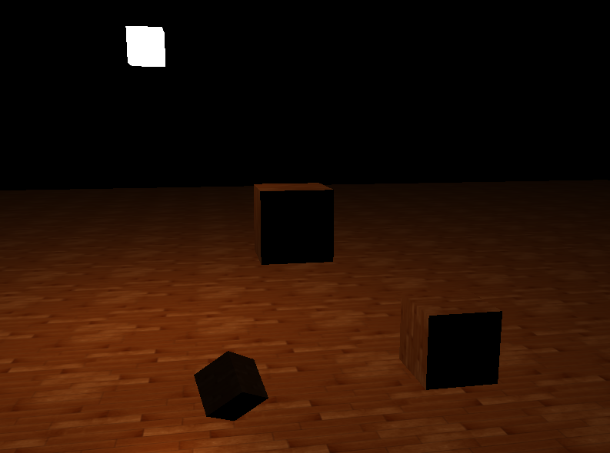
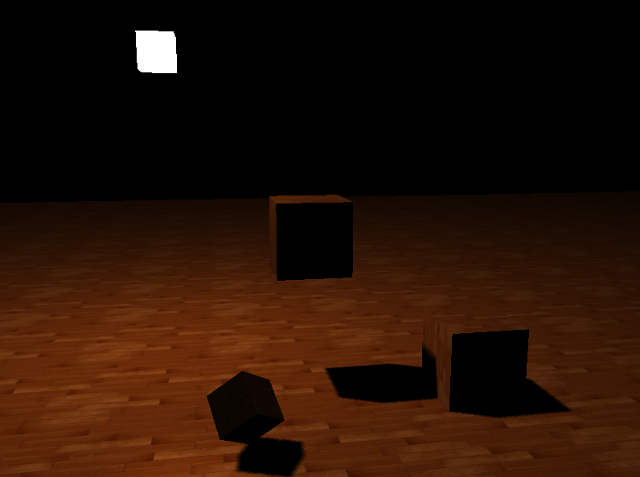
阴影映射
阴影是光线被阻挡的结果，光线由于遮挡不能达到一个物体表面时，那么这个物体就在阴影中了。阴影使场景更加真实，并且可以让观察者获得物体之间的空间位置关系。

Slide 5
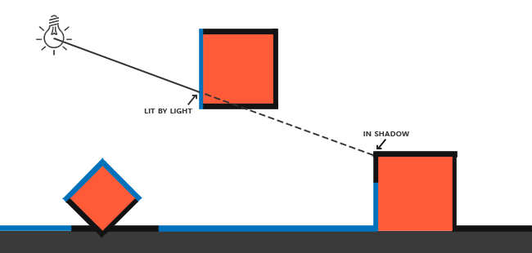
阴影映射
阴影映射(Shadow Mapping) ：以光的位置为视角进行渲染，能看到的东西被点亮，看不见的一定是在阴影之中。

Slide 6
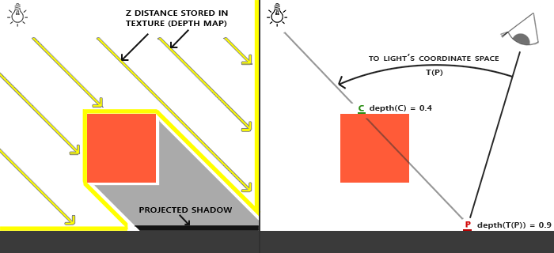
阴影映射
阴影映射(Shadow Mapping) ：以光的位置为视角进行渲染，能看到的东西被点亮，看不见的一定是在阴影之中。
渲染深度贴图
从光源的透视图来渲染场景，并把深度值的结果储存到纹理中
渲染场景
将片段变换到光源的坐标空间，使用生成的深度贴图来计算片段是否在阴影之中

Slide 7
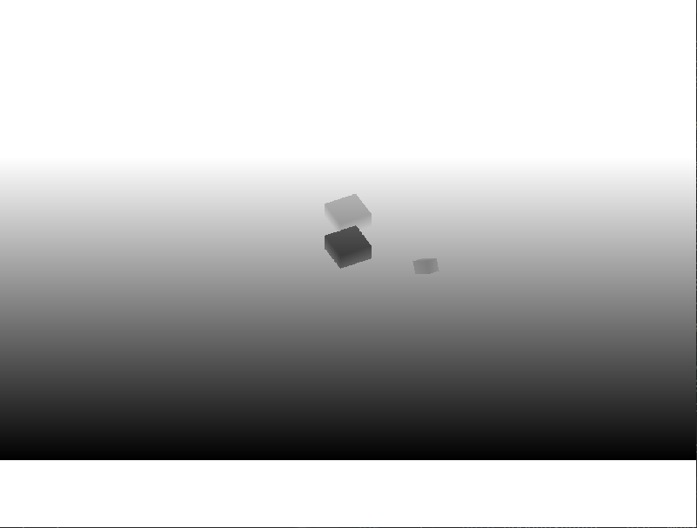
阴影映射
渲染深度贴图
Model
Light Space View
Light Space Projection
Vertex Shader
Depth Map

Slide 8
阴影映射
渲染场景
Model
Camera Space View
Camear Space Projection
Vertex Shader
Model
Light Space View
Light Space Projection
Fragment Shader

Slide 9
阴影映射
创建深度贴图缓冲
写入深度值
glGenFramebuffers(1, &m_uiFBO);
glBindFramebuffer(GL_FRAMEBUFFER, m_uiFBO);
glGenTextures(1, &m_uiDepthMap);
glBindTexture(GL_TEXTURE_2D, m_uiDepthMap);
glTexImage2D(GL_TEXTURE_2D, 0, GL_DEPTH_COMPONENT, m_iWidth, m_iHeight, 0, GL_DEPTH_COMPONENT, GL_FLOAT, NULL);
glTexParameteri(GL_TEXTURE_2D, GL_TEXTURE_MIN_FILTER, GL_NEAREST);
glTexParameteri(GL_TEXTURE_2D, GL_TEXTURE_MAG_FILTER, GL_NEAREST);
glTexParameteri(GL_TEXTURE_2D, GL_TEXTURE_WRAP_S, GL_CLAMP_TO_EDGE);
glTexParameteri(GL_TEXTURE_2D, GL_TEXTURE_WRAP_T, GL_CLAMP_TO_EDGE);
glFramebufferTexture2D(GL_FRAMEBUFFER, GL_DEPTH_ATTACHMENT, GL_TEXTURE_2D, m_uiDepthMap, 0);
glDrawBuffer(GL_NONE);
glReadBuffer(GL_NONE);
glBindFramebuffer(GL_FRAMEBUFFER, 0);
#version 420 core
layout (location = 0) in vec3 aPos;
uniform mat4 matModel;
uniform mat4 matLightSpace;
void main()
{
gl_Position = matLightSpace * matModel * vec4(aPos, 1.0);
}
#version 420 core
void main()
{
}

Slide 10
阴影映射
转换到光源空间
判断是否在阴影中
#version 420 core
layout (location = 0) in vec3 aPos;
layout (location = 1) in vec2 aTexCoord;
layout (location = 2) in vec3 aNormal;
out VS_OUT {
vec3 FragPos;
vec2 TexCoords;
vec3 Normal;
vec4 FragPosLightSpace;
} vs_out;
uniform mat4 matModel;
uniform mat4 matView;
uniform mat4 matProjection;
uniform mat4 matLightSpace;
void main()
{
vs_out.FragPos = vec3(matModel * vec4(aPos,1.0));
vs_out.Normal = mat3(transpose(inverse(matModel)))* aNormal;
vs_out.TexCoords = aTexCoord;
vs_out.FragPosLightSpace = matLightSpace * vec4(vs_out.FragPos,1.0);
gl_Position = matProjection * matView * vec4(vs_out.FragPos, 1.0);
}
float ShadowCalculation(vec4 fragPosLightSpace)
{
vec3 projCoords = fragPosLightSpace.xyz / fragPosLightSpace.w;
projCoords = projCoords * 0.5 + 0.5;
float closestDepth = texture(texture_diffuse1, projCoords.xy).r;
float currentDepth = projCoords.z;
float shadow = currentDepth > closestDepth ? 1.0 : 0.0;
return shadow;
}
void main()
{
vec3 color = texture(texture_diffuse2,fs_in.TexCoords).rgb;
vec3 normal = normalize(fs_in.Normal);
vec3 ambient = pointLights[0].ambient;
vec3 lightDir = normalize(pointLights[0].position - fs_in.FragPos);
float diff = max(dot(lightDir,normal),0.0);
vec3 diffuse = diff * pointLights[0].diffuse;
vec3 viewDir = normalize(viewPos - fs_in.FragPos);
vec3 halfwayDir = normalize(lightDir + viewDir);
float spec = pow(max(dot(normal,halfwayDir),0.0),pointLights[0].shininess);
vec3 specular = spec * pointLights[0].specular;
float shadow = bShadow ? ShadowCalculation(fs_in.FragPosLightSpace) : 0.0;
vec3 lighting = (ambient +(1.0-shadow)*(diffuse + specular))*color;
FragColor = vec4(lighting,1.0);
}

Slide 11
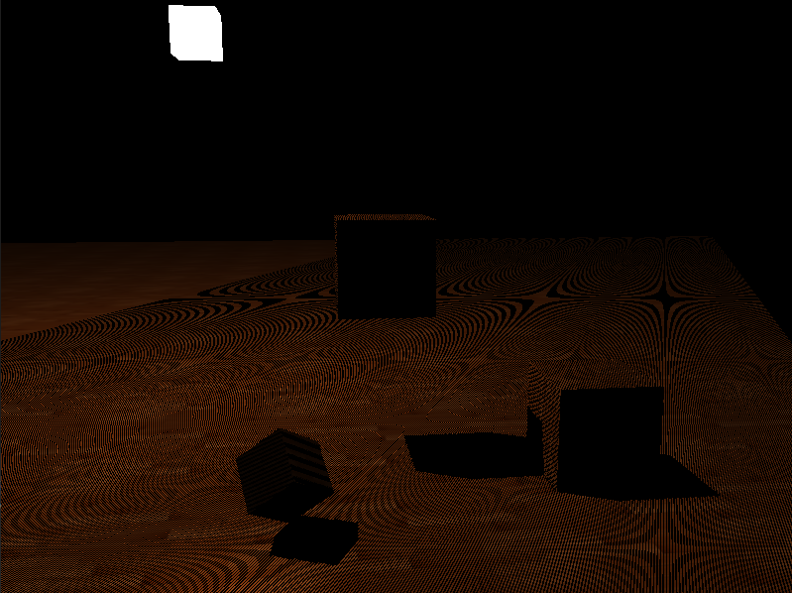
阴影映射
阴影贴图受限于分辨率，在距离光源比较远的情况下，多个片段可能从深度贴图的同一个值中去采样，渲染出很大一块交替黑线。这种阴影贴图的不真实感叫做阴影失真(Shadow Acne)

Slide 12
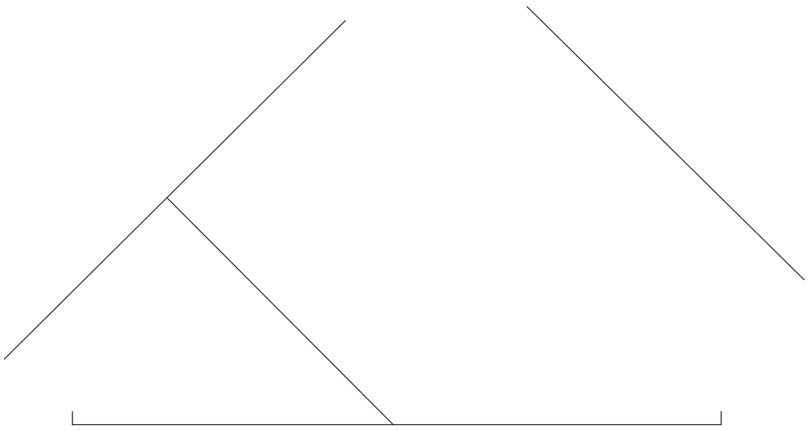

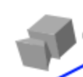
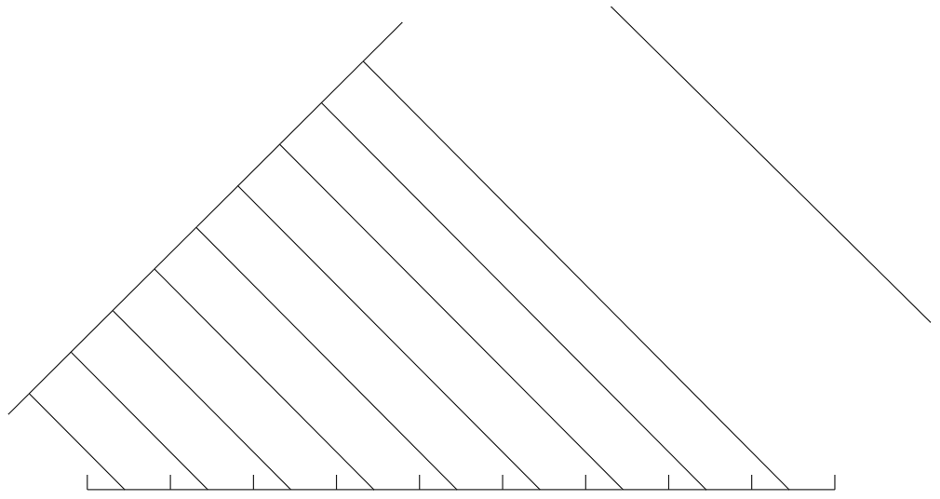
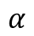
阴影映射
阴影失真
B
摄像机平面
摄像机平面
深度值
光平面
3
P
光平面
bias
A
1
2
3
4
5
6
7
8
9
$$α$$
H
L

Slide 13
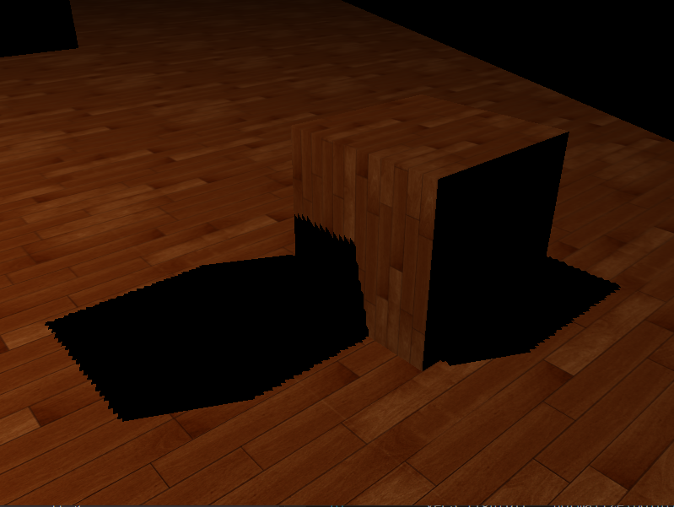
阴影映射
偏移有可能特别大，以至于可以看出阴影相对实际物体位置的偏移，这个阴影失真叫做悬浮(Peter Panning)，物体看起来轻轻悬浮在表面之上。
float ShadowCalculation(vec4 fragPosLightSpace)
{
vec3 projCoords = fragPosLightSpace.xyz / fragPosLightSpace.w;
projCoords = projCoords * 0.5 + 0.5;
float closestDepth = texture(texture_diffuse1, projCoords.xy).r;
float currentDepth = projCoords.z;
float bias = max(0.05 * (1.0 - dot(normal, lightDir)), 0.005);
float shadow = currentDepth - bias > closestDepth ? 1.0 : 0.0;
return shadow;
}

Slide 14
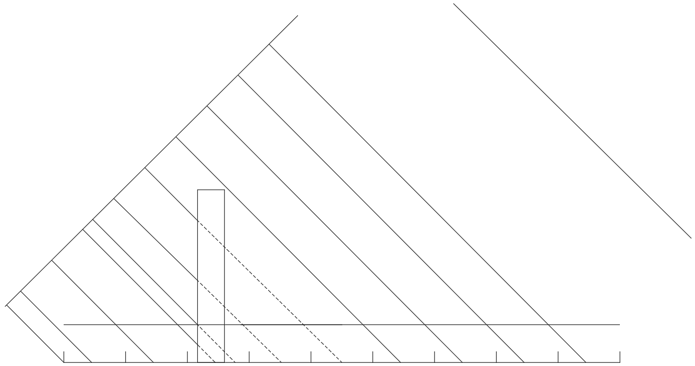
阴影映射
阴影悬浮
偏移有可能特别大，以至于可以看出阴影相对实际物体位置的偏移，这个阴影失真叫做悬浮(Peter Panning)，物体看起来轻轻悬浮在表面之上。
摄像机平面
光平面
bias平面
A
B

Slide 15
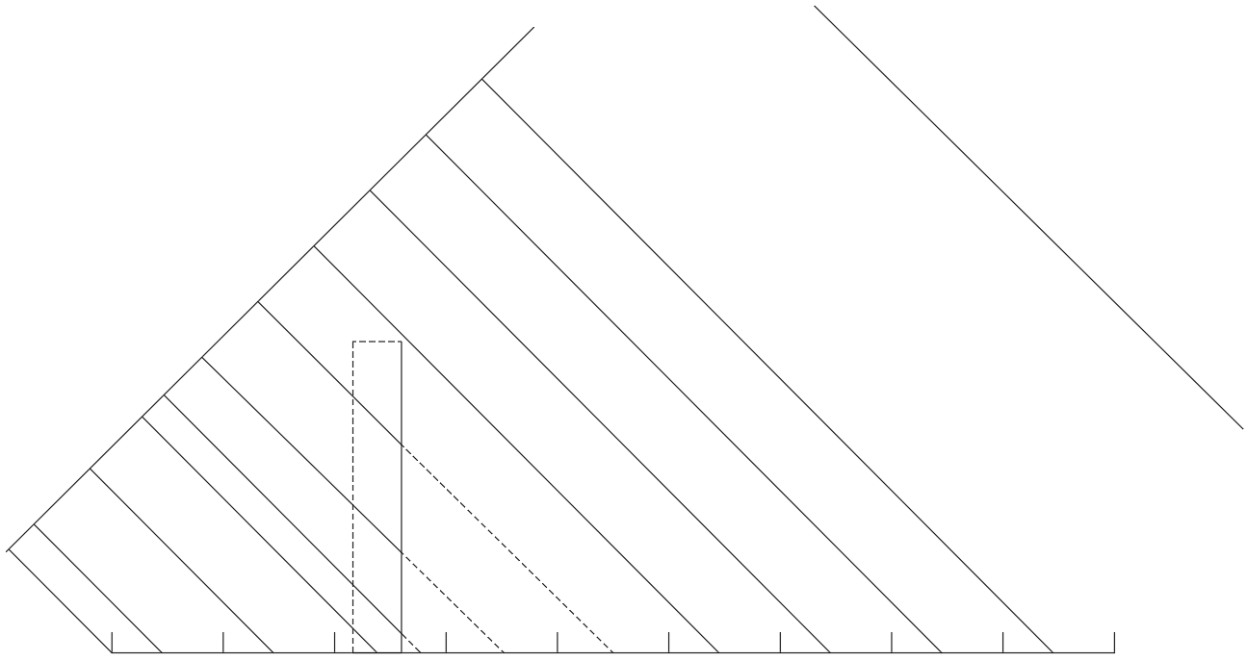
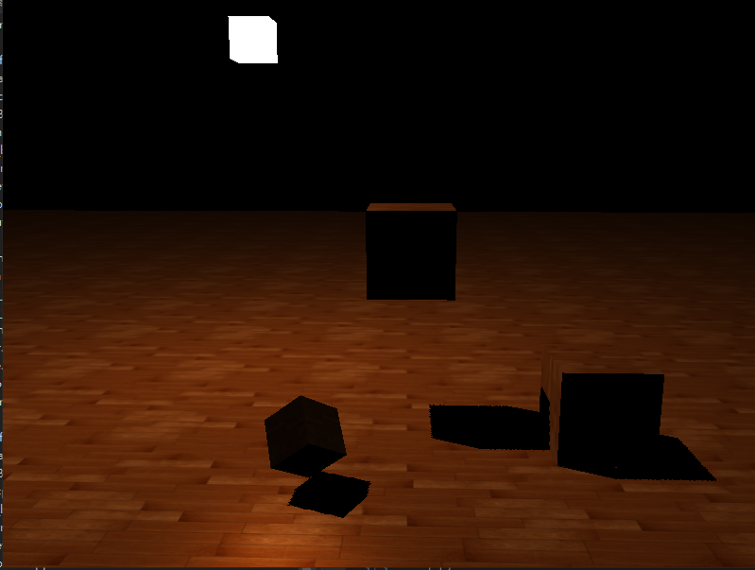
阴影映射
正面剔除
未开启正面/开启背面剔除，深度值为柱子的实线部分交叉点，会在实线上产生条纹。开启正面剔除后，由于在柱子内部,一般看不到，所以就解决了黑色条纹的问题。
摄像机平面
光平面

Slide 16
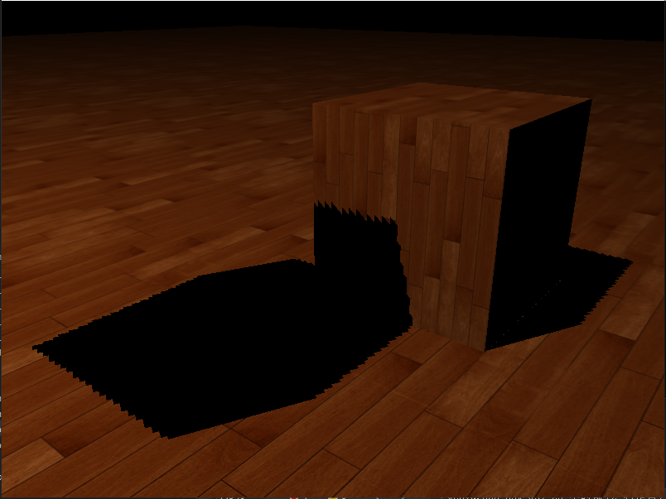
阴影映射
PCF(percentage-closer filtering)，是一种多个不同过滤方式的组合，使用这种方式产生柔和阴影。核心思想是从深度贴图中多次采样，所有的采样结果结合在一起，进行平均化。
float ShadowCalculation(vec4 fragPosLightSpace)
{
vec3 projCoords = fragPosLightSpace.xyz / fragPosLightSpace.w;
projCoords = projCoords * 0.5 + 0.5;
if(projCoords.z > 1.0)
return 0.f;
float closestDepth = texture(texture_diffuse1,projCoords.xy).r;
float currentDepth = projCoords.z;
vec3 normal = normalize(fs_in.Normal);
vec3 lightDir = normalize( pointLights[0].position - fs_in.FragPos);
float bias = max(0.05 * (1.0 - dot(normal, lightDir)), 0.005);
float shadow = 0.0;
vec2 texelSize = 1.0/(textureSize(texture_diffuse1,0));
for(int x = -1; x <= 1; ++x)
{
for(int y = -1; y <= 1; ++y)
{
float pcfDepth = texture(texture_diffuse1, projCoords.xy + vec2(x, y) * texelSize).r;
shadow += currentDepth - bias > pcfDepth ? 1.0 : 0.0;
}
}
shadow /= 9.0;
return shadow;
}

Slide 17
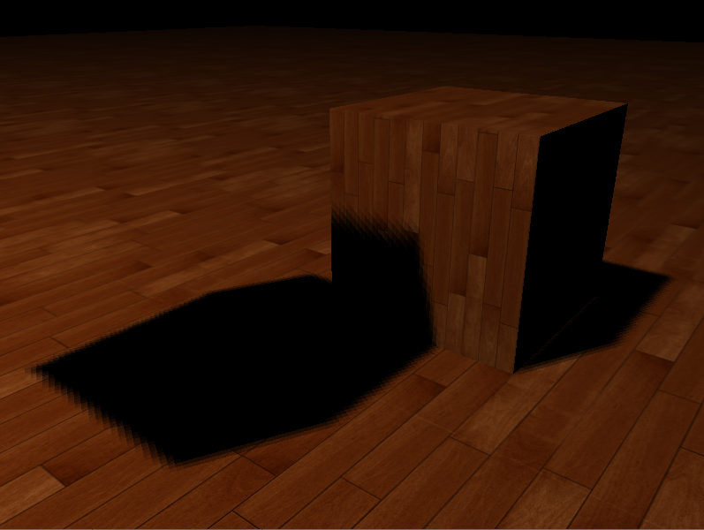
阴影映射
PCF(percentage-closer filtering)，是一种多个不同过滤方式的组合，使用这种方式产生柔和阴影。核心思想是从深度贴图中多次采样，所有的采样结果结合在一起，进行平均化。

Slide 18
2
点光源阴影

Slide 19
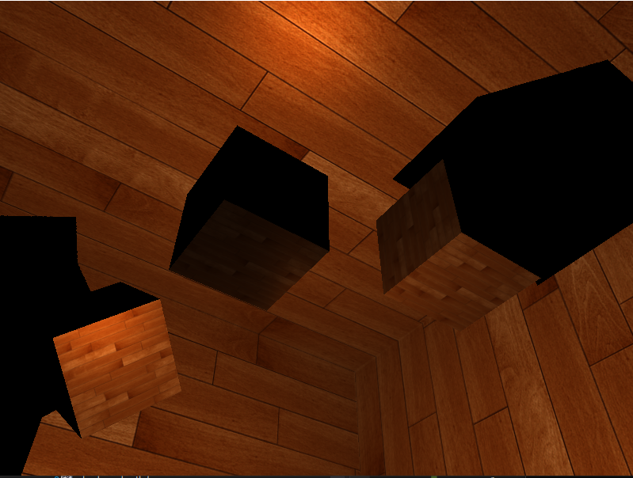
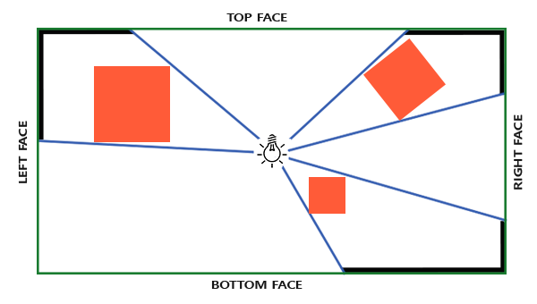
点光源阴影
点光源阴影，也叫万向阴影贴图(omnidirectional shadow maps)，适用于点光源，生成所有方向上的阴影。

Slide 20
点光源阴影
创建深度贴图缓冲
glGenFramebuffers(1, &m_uiFBO);
glBindFramebuffer(GL_FRAMEBUFFER, m_uiFBO);
glGenTextures(1, &m_uiDepthMap);
glBindTexture(GL_TEXTURE_CUBE_MAP, m_uiDepthMap);
for (GLuint i = 0; i < 6; i++)
{
glTexImage2D(GL_TEXTURE_CUBE_MAP_POSITIVE_X + i, 0, GL_DEPTH_COMPONENT,
m_iWidth, m_iHeight, 0, GL_DEPTH_COMPONENT, GL_FLOAT, NULL);
}
glTexParameteri(GL_TEXTURE_CUBE_MAP, GL_TEXTURE_MIN_FILTER, GL_NEAREST);
glTexParameteri(GL_TEXTURE_CUBE_MAP, GL_TEXTURE_MAG_FILTER, GL_NEAREST);
glTexParameteri(GL_TEXTURE_CUBE_MAP, GL_TEXTURE_WRAP_S, GL_CLAMP_TO_EDGE);
glTexParameteri(GL_TEXTURE_CUBE_MAP, GL_TEXTURE_WRAP_T, GL_CLAMP_TO_EDGE);
glTexParameteri(GL_TEXTURE_CUBE_MAP, GL_TEXTURE_WRAP_R, GL_CLAMP_TO_EDGE);
glFramebufferTexture(GL_FRAMEBUFFER, GL_DEPTH_ATTACHMENT, m_uiDepthMap, 0);
glDrawBuffer(GL_NONE);
glReadBuffer(GL_NONE);
glBindFramebuffer(GL_FRAMEBUFFER, 0);

Slide 21
点光源阴影
写入深度值
#version 420 core
layout (location = 0) in vec3 aPos;
uniform mat4 matModel;
void main()
{
gl_Position = matModel * vec4(aPos, 1.0);
}
#version 420 core
layout (triangles) in;
layout (triangle_strip, max_vertices = 18) out;
uniform mat4 matLightSpace[6];
out GS_OUT {
vec4 FragPos;
} gs_out;
void main()
{
for(int face = 0; face < 6; ++face)
{
gl_Layer = face;
for(int i = 0; i < 3; ++i)
{
gs_out.FragPos = gl_in[i].gl_Position;
gl_Position = matLightSpace[face] * gs_out.FragPos;
EmitVertex();
}
EndPrimitive();
}
}
void main()
{
float length = length(fs_in.FragPos.xyz - pointLights[0].position);
float lightDistance = length/far_plane;
gl_FragDepth = lightDistance;
FragColor = vec4(vec3(lightDistance),1.0);
}

Slide 22
点光源阴影
判断是否在阴影中
void main()
{
vec3 color = texture(texture_diffuse1,fs_in.TexCoords).rgb;
vec3 normal = normalize(fs_in.Normal);
vec3 ambient = pointLights[0].ambient;
vec3 lightDir = normalize(pointLights[0].position - fs_in.FragPos);
float diff = max(dot(lightDir,normal),0.0);
vec3 diffuse = diff * pointLights[0].diffuse;
vec3 viewDir = normalize(viewPos - fs_in.FragPos);
vec3 halfwayDir = normalize(lightDir + viewDir);
float spec = pow(max(dot(normal,halfwayDir),0.0),pointLights[0].shininess);
vec3 specular = spec * pointLights[0].specular;
float shadow = bShadow ? ShadowCalculation0(fs_in.FragPos) : 0.0;
vec3 lighting = (ambient +(1.0-shadow)*(diffuse + specular))*color;
FragColor = vec4(lighting,1.0);
}
float ShadowCalculation0(vec3 fragPos)
{
vec3 fragToLight = fragPos - pointLights[0].position;
float closetDepth = texture(texture_cube_map1,fragToLight).r;
closetDepth *= far_plane;
float currentDepth = length(fragToLight);
float bias = 0.05;
float shadow = currentDepth-bias> closetDepth ?1.0:0.0;
return shadow;
}

Slide 23
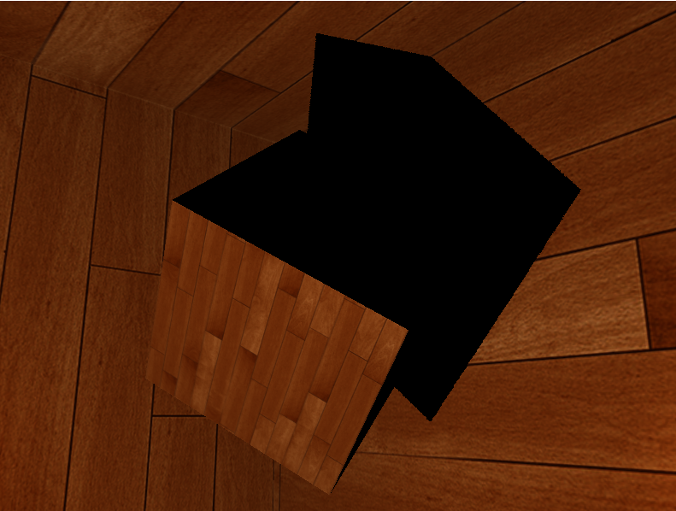
点光源阴影
PCF(percentage-closer filtering)，是一种多个不同过滤方式的组合，使用这种方式产生柔和阴影。核心思想是从深度贴图中多次采样，所有的采样结果结合在一起，进行平均化。
float ShadowCalculation1(vec3 fragPos)
{
vec3 fragToLight = fragPos - pointLights[0].position;
float currentDepth = length(fragToLight);
float shadow = 0.0;
float bias = 0.05;
float samples = 4.0;
float offset = 0.1;
for(float x = -offset; x<offset; x += offset/(samples*0.5))
{
for(float y = -offset; y < offset; y += offset/(samples*0.5))
{
for(float z = -offset; z < offset; z += offset/(samples*0.5))
{
float closetDepth = texture(texture_cube_map1,fragToLight + vec3(x,y,z)).r;
closetDepth *= far_plane;
if(currentDepth - bias > closetDepth)
shadow += 1.0;
}
}
}
shadow /= (samples*samples*samples);
return shadow;
}

Slide 24
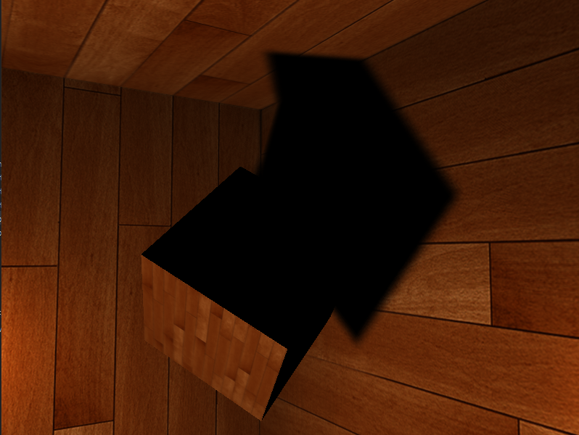
点光源阴影
PCF(percentage-closer filtering)，是一种多个不同过滤方式的组合，使用这种方式产生柔和阴影。核心思想是从深度贴图中多次采样，所有的采样结果结合在一起，进行平均化。

Slide 25
点光源阴影
PCF(percentage-closer filtering)，是一种多个不同过滤方式的组合，使用这种方式产生柔和阴影。核心思想是从深度贴图中多次采样，所有的采样结果结合在一起，进行平均化。
float ShadowCalculation2(vec3 fragPos)
{
vec3 fragToLight = fragPos - pointLights[0].position;
float currentDepth = length(fragToLight);
float shadow = 0.0;
float bias = 0.15;
float samples =20.0;
float offset = 0.05;
vec3 sampleOffsetDirections[20] = vec3[]
(
vec3( 1, 1, 1), vec3( 1, -1, 1), vec3(-1, -1, 1), vec3(-1, 1, 1),
vec3( 1, 1, -1), vec3( 1, -1, -1), vec3(-1, -1, -1), vec3(-1, 1, -1),
vec3( 1, 1, 0), vec3( 1, -1, 0), vec3(-1, -1, 0), vec3(-1, 1, 0),
vec3( 1, 0, 1), vec3(-1, 0, 1), vec3( 1, 0, -1), vec3(-1, 0, -1),
vec3( 0, 1, 1), vec3( 0, -1, 1), vec3( 0, -1, -1), vec3( 0, 1, -1)
);
for(int i=0;i<samples;++i)
{
float closetDepth = texture(texture_cube_map1,fragToLight + sampleOffsetDirections[i] * offset).r;
closetDepth *= far_plane;
if(currentDepth - bias > closetDepth)
shadow += 1.0;
}
shadow /= samples;
return shadow;
}

Slide 26
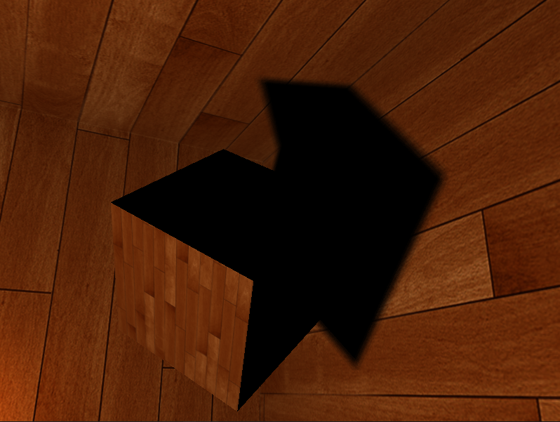
点光源阴影
PCF(percentage-closer filtering)，是一种多个不同过滤方式的组合，使用这种方式产生柔和阴影。核心思想是从深度贴图中多次采样，所有的采样结果结合在一起，进行平均化。

Slide 27
谢谢大家
THANK YOU FOR WATCHING

